Slide 1
Congestion Management in Datacenter Networks:
Status Quo and Opportunities
Chen Tian（田臣）
Nanjing University

Slide 2
Background
1
2
Our Thoughts
Outline
Congestion Control
3
Our Work
Flow Control
4
Future Work
Remote Flow Control

Slide 3

Background
1
2
Our Thoughts
Outline
3
Our Work
4
Future Work

Slide 4







DC Apps demand ultra-low latency
Background
Notes:
new applications like storage on high I/O speed media, e.g. NVMe (non-volatile memory express) and large-scale machine learning training on high computation speed devices

Slide 5



Latency costs!
The 100ms Rule
Amazon every 100ms of latency
Cost 1% in sales
Google every 500ms of latency
Traffic drop 20%
*data from https://akfpartners.com/growth-blog/what-is-latency
Background

Slide 6
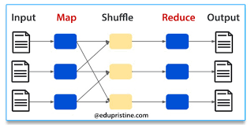
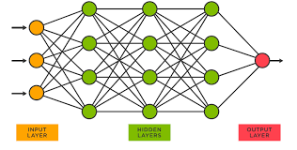
Average/tail both matter
Not only average latency, but also (maybe more important) tail latency
Map-reduce task in Hadoop/spark system
Forward and backward propagation of Neural Network
Background
Notes:
大数据系统Map-reduce，和机器学习系统中，一轮迭代需要依赖于所有流量的完成

Slide 7
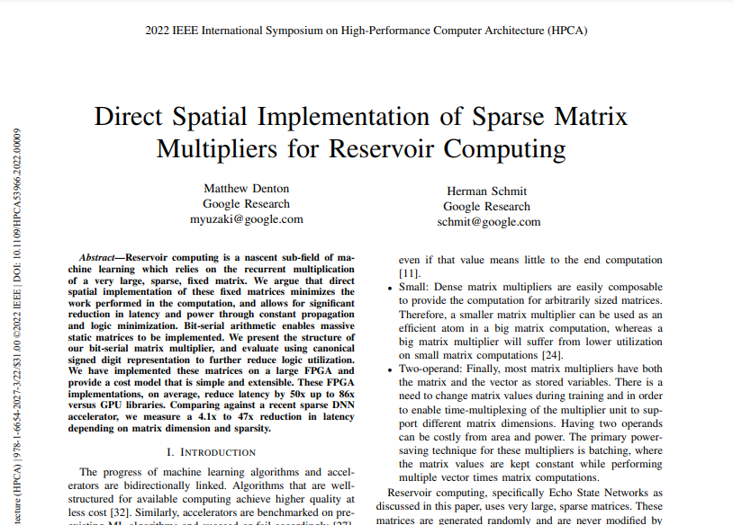
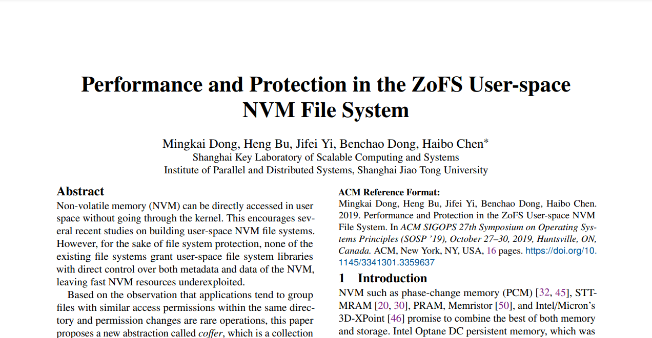
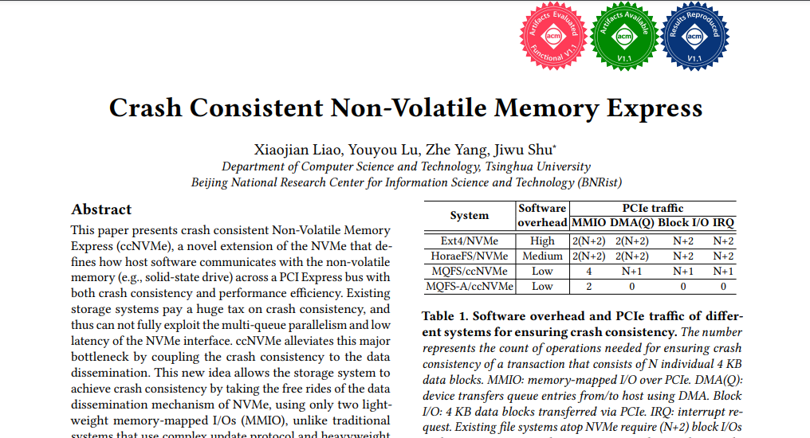

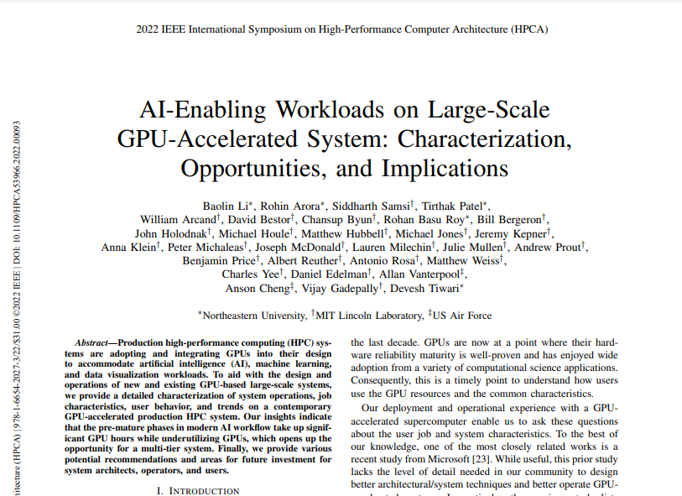
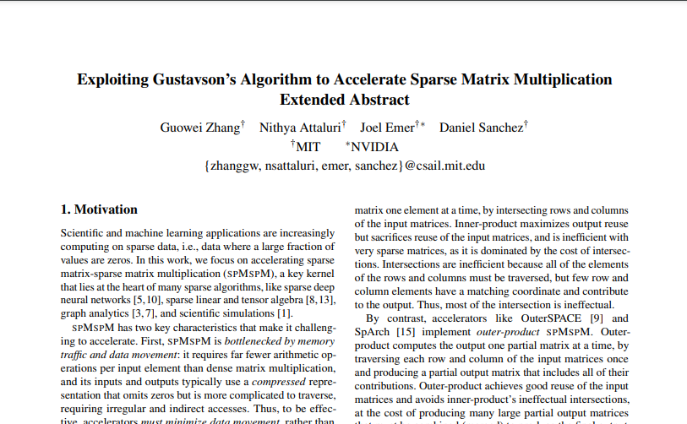
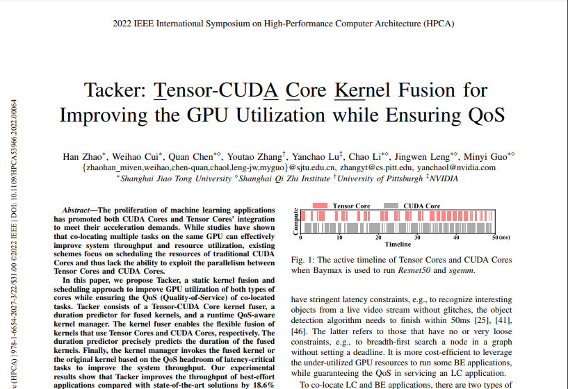

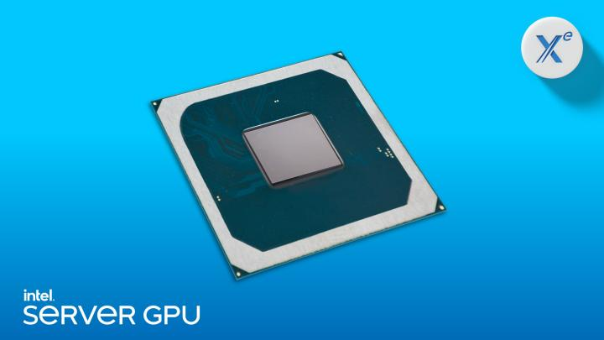
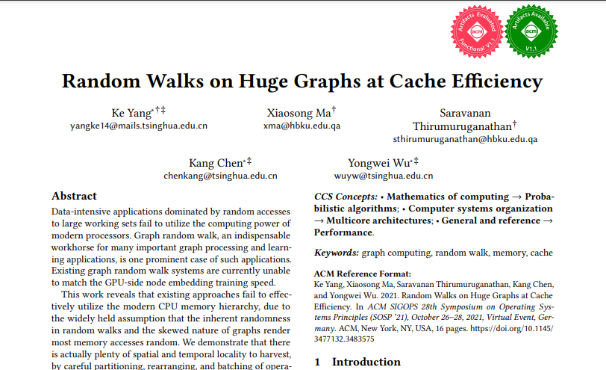
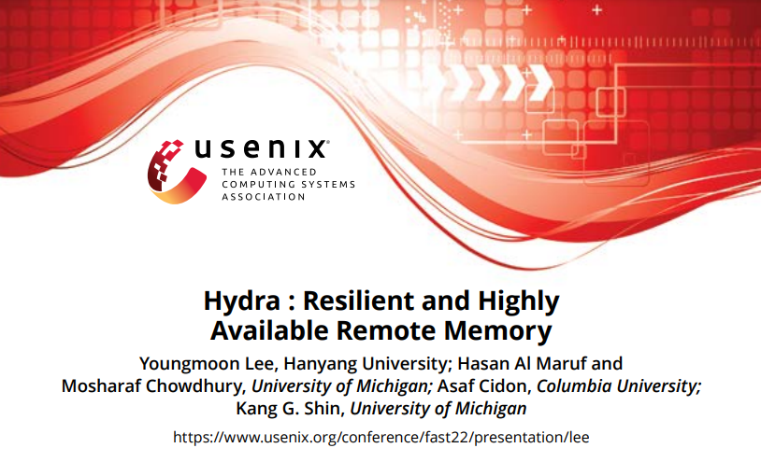
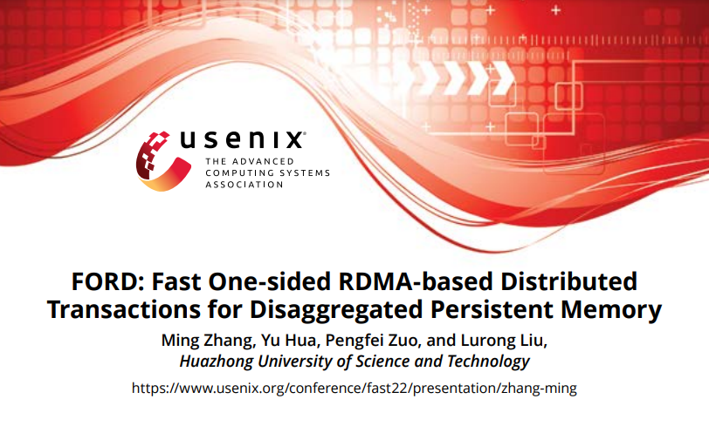
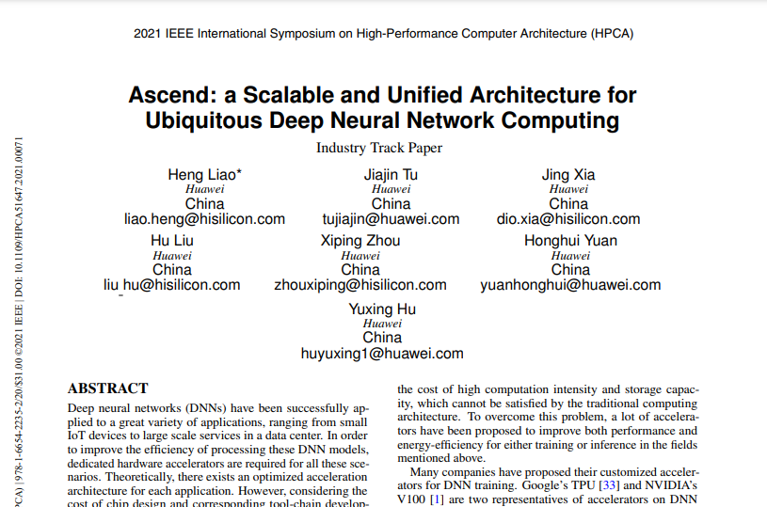


Network: new bottleneck (again)
μs-scale computation
Compute
NVM storage
Storage
Network
Background
Notes:
(click) 存储介质在飞速发展，从HDD到SSD再到NVM非易失性存储介质不断涌现；
(click) 计算算力也在不断发展，从CPU到更加专用的GPU，DPU等； (click) 网络逐渐成为数据中心的瓶颈， 现在又出现存算分离场景，在此场景下，节点间通讯需求增加。
NVM：非易失性内存
Cite: Network Requirements for Resource Disaggregation (OSDI’16)
Jupiter Evolving: Transforming Google’s Datacenter Network via Optical Circuit Switches and Software-Defined Networking (SIGCOMM’22)
会议来自：SOSP, ASPLOS, FAST, HPCA等

Slide 8
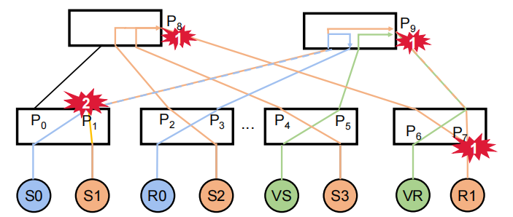
Why care congestion?
Path collision
Incast
Background

Slide 9
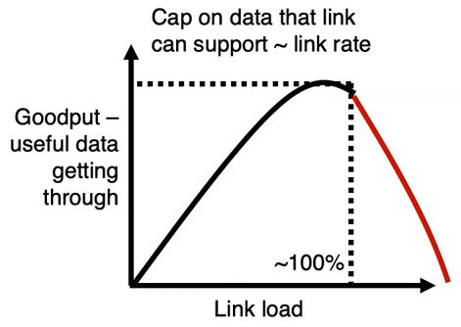
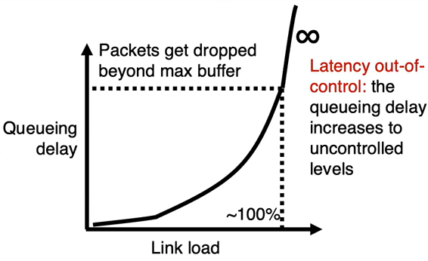
What if uncontrolled?
*Pic. from Congestion Control, SIGCOMM'22 Topic Preview
Background
Notes:
Cite: Congestion Control (SIGCOMM'22 Topic Preview)

Slide 10
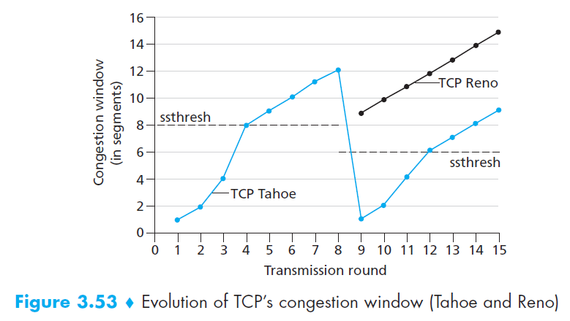
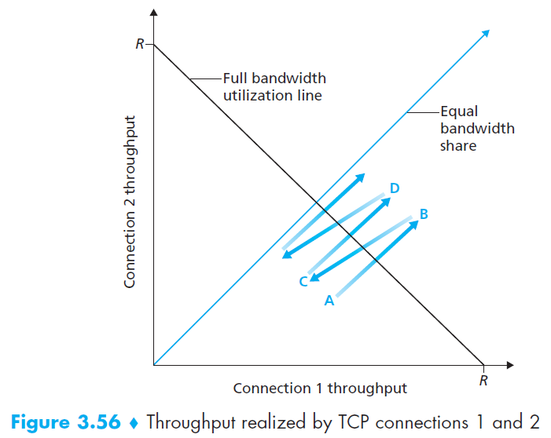
What we learn from textbook
TCP Slow start
Additive-increase/multiplicative-decrease (AIMD) rate adjusting
*pics from Computer Networking: A Top-Down Approach
Background

Slide 11

DCN is far different from WAN!
WAN (Wide area network)
Low per-conn bandwidth
Long distance
TCP/IP stack overhead
Heterogeneous devices
Low base RTT
DCN (Datacenter Network)
High per-conn bandwidth
μs-scale propagation delay
Ultra-low delay on end-hosts (RDMA)
Regular topologies and devices
Environments
Background
Notes:
DC regular的topo给了CC更多的设计空间，但是高链路带宽和传播时延也给CC带来了更大的需求

Slide 12



DCN traffic pattern
Bursty on-off traffic
Incast (many-to-one)
All-to-all
Server
When congestion occurs (which is unavoidable and common), queuing delay dominate FCT of flows
Server
Client
Switch
Server
Background
Notes:
在数据中心中，流量的特征是突发式的潮汐流量，峰值负载很高；（click）且网络分布式的特点决定了多打一的incast流量模式是很常见的。
一方面数据中心提供了高带宽和基础的低时延，另一方面流量特征又使得网络的突发很常见；
（click）数据中心的这些特征共同使得流量在网络内的排队时延成为主导流量完成时间的关键因素。

Slide 13

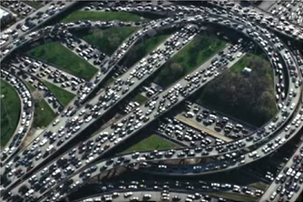
Congestion management
handle congestion to avoid collapse and provide good performance.
Including congestion control and flow control.
Google Map：
Which route?
Or should not go out today?
Traffic light：
When to stop?
When to move?
when too many senders sending too fast…
congestion control : solving the congestion in-network
when the receiver has no ability to receive…
flow control : solving the congestion on per-hop/endhost receiver entity
Background

Slide 14

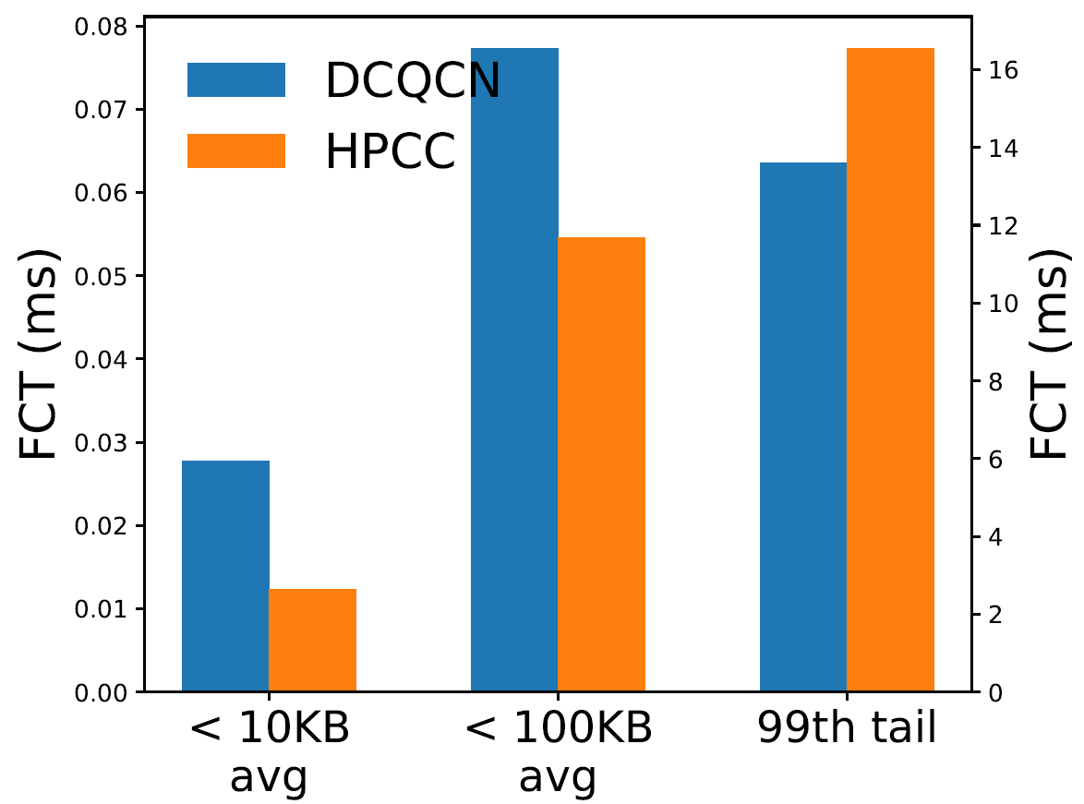
Challenges
Achieving low latency for small flows and tail network latency is not easy
Low latency for small flows
Small queue occupancy
High bandwidth for large flows
Queue cannot be too small
*pics from Paydebt
Background

Slide 15
Background
Congestion Control
1
Flow Control
2
Our Thoughts
Outline
Intermediate zone
3
Our Work
4
Future Work

Slide 16
Overview of state-of-the-art CM
Congestion Control
Flow Control
DCTCP, DCQCN, TIMELY, HPCC, Swift, PowerTCP, On-Ramp,
PFC, CBFC, BFC…
TCD
ExpressPass, pHost, Homa, NDP, Aeolus…
Related works

Slide 17
Congestion Control
Reactive
Congestion Control
Proactive
Congestion Control
DCTCP, DCQCN, TIMELY, HPCC, Swift, PowerTCP, On-Ramp, …
React to congestion signals.
ExpressPass, pHost, Homa,
NDP, Aeolus, …
Use credits to schedule the transmission of packets.
Related works
Notes:
At least one-RTT required before reaction.
Meets the first-RTT problem.

Slide 18


Reactive Congestion Control (RCC)
React to congestion signals AFTER congestion occurs.
At least several RTTs are needed to converge.
Sender
Receiver
data
ACK
RTT
(TIMELY, Swift)
ECN (DCTCP, DCQCN)
INT (HPCC)
Related works

Slide 19
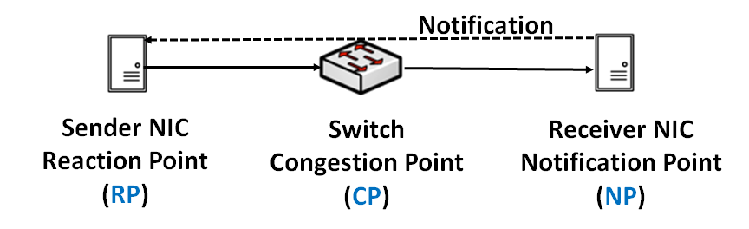
ECN-based RCC
ECN based
e.g., DCTCP, DCQCN
*Congestion Control for Large-Scale RDMA Deployments. Yibo Zhu. SIGCOMM. 2015.
Related works

Slide 20
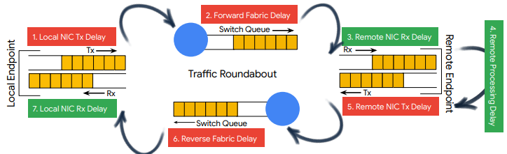
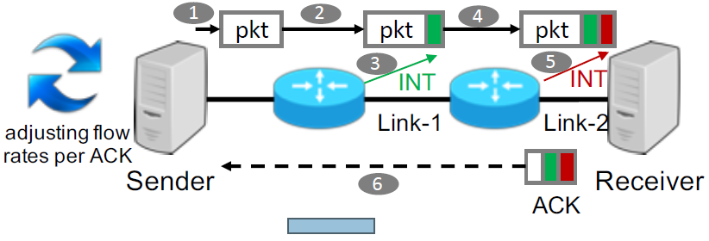
RTT or INT based RCC
delay based
e.g., Swift, TIMELY
(Pic. from Swift)
INT based
e.g., HPCC, PowerTCP
*TIMELY: RTT-based Congestion Control for the Datacenter. Radhika Mittal. SIGCOMM. 2015.
Swift: Delay is Simple and Effective for Congestion Control in the Datacenter. Gautam Kumar. SIGCOMM. 2020.
(Pic. from HPCC)
*HPCC: high precision congestion control. Yuliang Li. SIGCOMM. 2019.
Related works

Slide 21
Proactive Congestion Control (PCC)
Schedule network transfer BEFORE sending.
Usually transmit a portion of unscheduled packets before bandwidth allocation, which also induces bursts.
Sender
Receiver
NOTE: We could use Token-based CC and Proactive CC alternately in our following slides.
Token
Unsch
Sch
Token allocation
(Homa, ExpressPass, NDP)
Related works

Slide 22
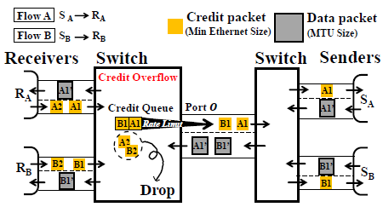
Pure PCC: ExpressPass
Promise 1: near-zero queue
Promise 2: zero packet loss
Promise 3: fast convergence
(Pic. from ExpressPass)
*Credit-Scheduled Delay-Bounded Congestion Control for Datacenters. Inho Cho. SIGCOMM. 2017.
Related works

Slide 23
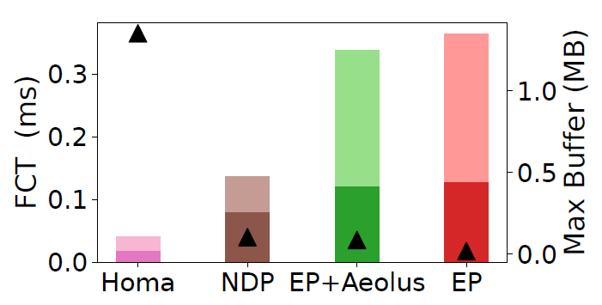
Waste of the first-RTT hurts
(Pic. from Aeolus)
(Pic. from TCC, Memcached, 100 Gbps)
Most flows (w/o congestion) could have been finished within the first RTT!
Related works

Slide 24
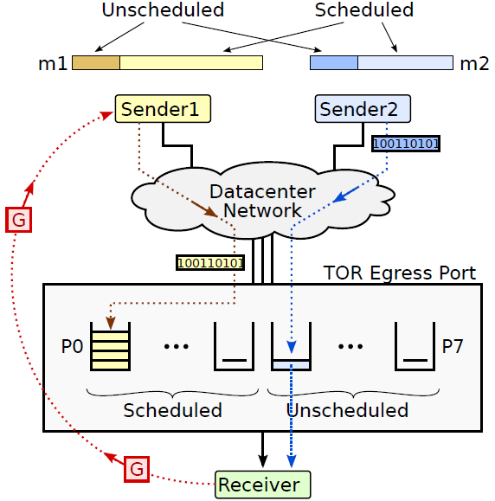
Homa
Scheduled: adaptive priority
Unscheduled: priority thresholds
Unscheduled: higher priorities
(Pic. from Homa)
*Homa: a receiver-driven low-latency transport protocol using network priorities. Behnam Montazeri. SIGCOMM. 2018.
Related works

Slide 25
NDP
Packet trimming → deterministic packet loss
Receiver-driven packets pulling
Sender
Receiver
Payload
Header
Pull
Payload trimming
*Re-architecting datacenter networks and stacks for low latency and high performance. Mark Handley. SIGCOMM. 2017.
Related works

Slide 26
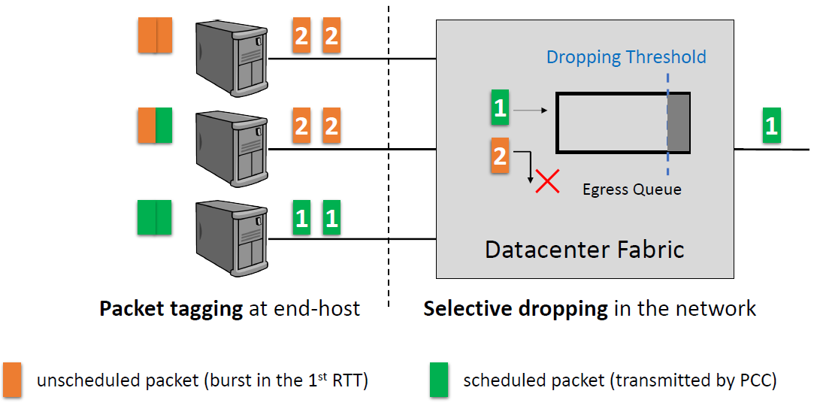
Aeolus
A patch to PCC
Send unscheduled packets at the first RTT aggressively
selectively drop unscheduled
(Pic. from Aeolus)
*Aeolus: A Building Block for Proactive Transport in Datacenters. Shuihai Hu. SIGCOMM. 2020.
Related works

Slide 27
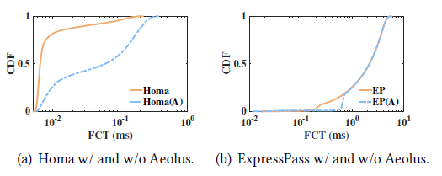
Aggressive injection may not help
(Pic. from Paydebt)
To send unscheduled, or not to be, that is the question.
Related works

Slide 28


Can FC address 1st RTT dilemma?
FC can ensure that buffer does not overflow
≠ a good application level performance (e.g., FCT)
Side effects are:
Congestion spreading
HOL-blocking -> victim flow problem
…
Related works
Notes:
这张图：大车（non-incast）和小车(incast)混合在一起控制

Slide 29
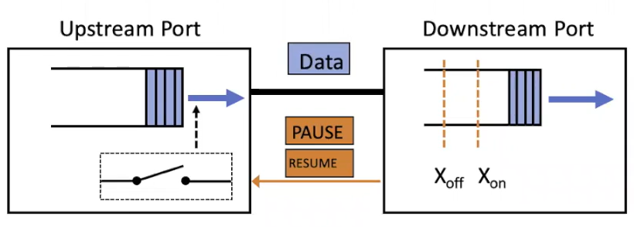
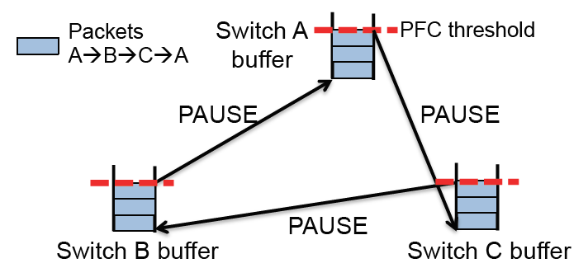
PFC (FC in Ethernet)
Pause an upstream port if the ingress queue length exceeds a threshold.
Operates at a per-port granularity.
HOL-blocking, congestion spreading and deadlock.
(Pic. from TCD, sigcomm21)
*IEEE 802.1 Qbb - Priority-based Flow Control. http://www.ieee802.org/1/ pages/802.1bb.html. 2010.
Related works

Slide 30
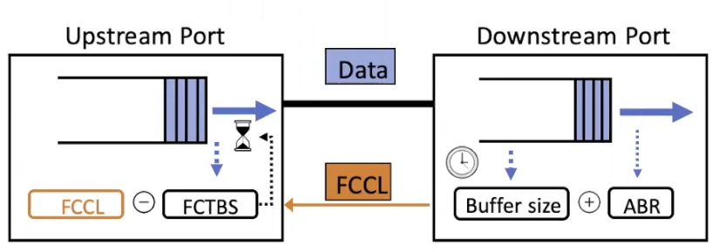
CBFC (FC in Infiniband)
The downstream switch sends a Flow Control Credit Limit (FCCL) message to the upstream switch periodically.
The upstream switch uses FCCL to calculate the number of credits.
Still could not avoid HOL blocking.
(Pic. from TCD, sigcomm21)
*InfiniBandTM Architecture Specification Volume 1 Release 1.4. https://cw.infinibandta.org/document/dl/8567. InfiniBand Trade Association. 2020.
Related works

Slide 31
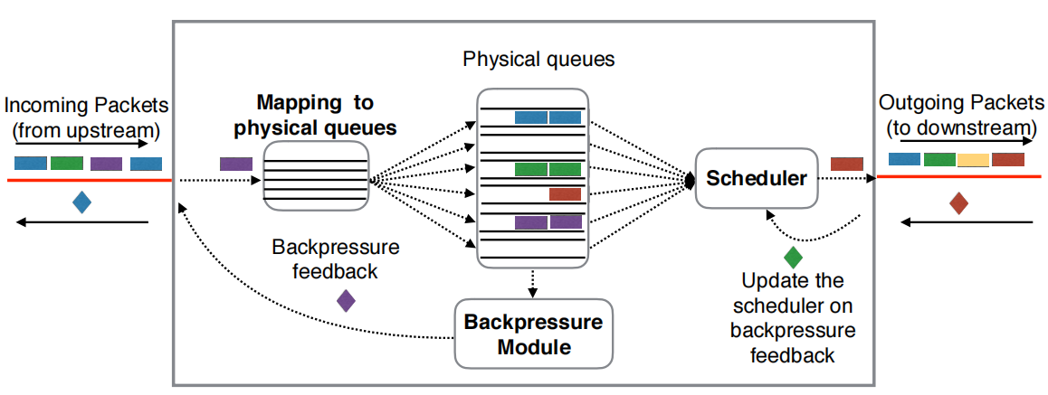
BFC
Flows are assigned to 32-128 queues per port according to <flow-ids, hash>.
A flow is assigned to an empty queue if possible and could share with other flows when all queues are occupied.
HOL blocking still occurs when different flows share the same queue.
*Backpressure Flow Control. Prateesh Goyal. NSDI. 2022.
Related works

Slide 32
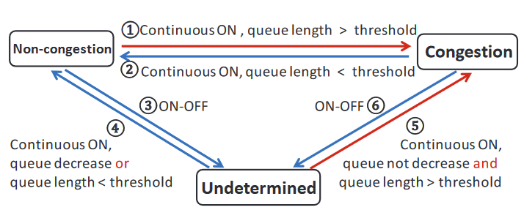
Intermediate zone - TCD
Current CC and FC are incompatible
The on-off control of FC could influence the congestion detection of CC
Introduce a third state “undetermined” to avoid sending rate reduction by CC on senders
Does not address HOL blocking caused by FC itself
*Congestion Detection in Lossless Network. Yiran Zhang. SIGCOMM. 2021.
Related works

Slide 33
Background
1
2
Our Thoughts
Trends in DC
Outline
Our vision
3
Our Work
4
Future Work

Slide 34
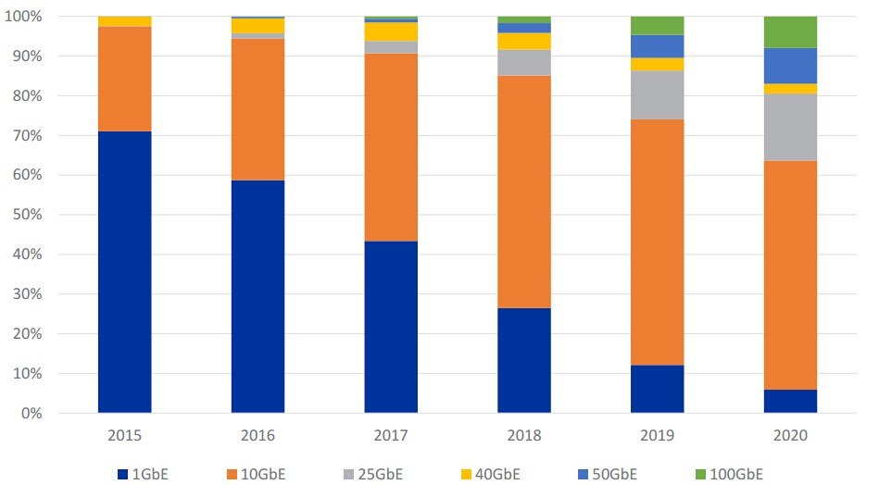
Several trends in datacenter
BDP is now 10-100x higher (due to link speed)
More flows could finish transmitting within the first BDP (before CC even steps in).
(Pic. from FS community)
(Pic. from Aeolus)
Related works

Slide 35

Several trends in datacenter
Datacenter is now hyperscale (up to 2,600,000 servers)
Incast scale can be 10-100x.
(Pic. from servertech)
Related works

Slide 36
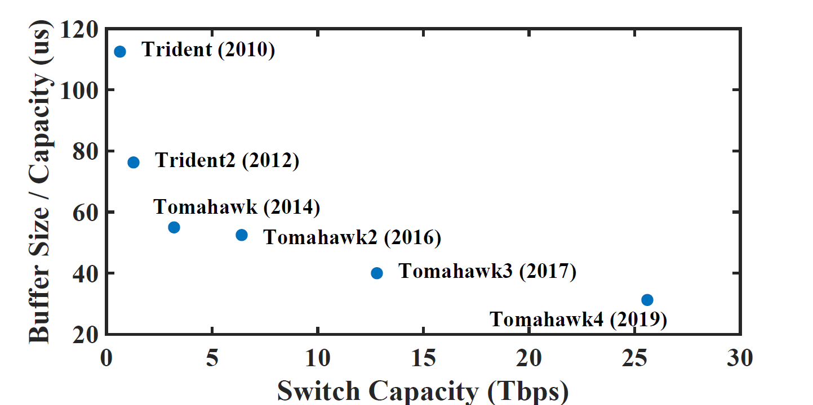
Several trends in datacenter
Switches’ relative buffering capacity is decreasing
(Pic. extended from BFC)
CC Alone is not effective!
Related works

Slide 37
Revisiting existing solutions
Strong CC to handle congestion
Congestion Control
Flow Control
DCTCP, DCQCN, TIMELY, HPCC, Swift, PowerTCP, On-Ramp,
PFC, CBFC, BFC…
TCD
ExpressPass, pHost, Homa, NDP, Aeolus…
Relatively “weak” FC to avoid buffer overflow
Our vision

Slide 38


Times have changed
Our vision

Slide 39
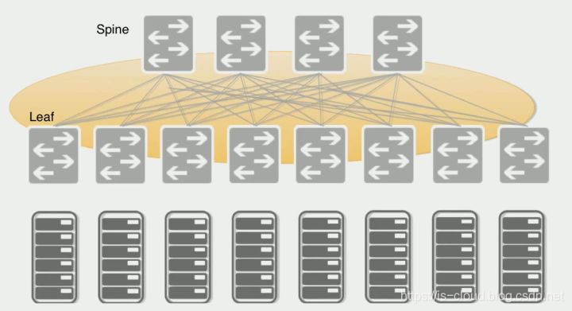
Role diff between CC & FC
Flow Control：Already injected packets
CC&FC Boundary
Congestion Control：Not yet injected packets

Slide 40

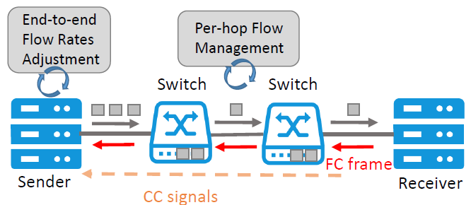
Our vision
Control different traffic (e.g., congested/non-congested) separately
Strong FC to handle transient congestion
Low latency
High throughput
Convergence
Fairness
Relatively “weak” CC to handle persistent congestion
Our vision

Slide 41

Background
1
2
Our Thoughts
Outline
Congestion Control
3
Our Work
Flow Control
4
Future Work
Remote Flow Control

Slide 42
Background
1
2
Our Thoughts
Outline
Congestion Control
3
Our Work
Flow Control
4
Future Work
Remote Flow Control

Slide 43
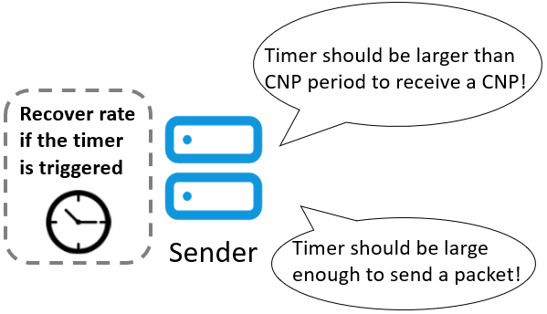
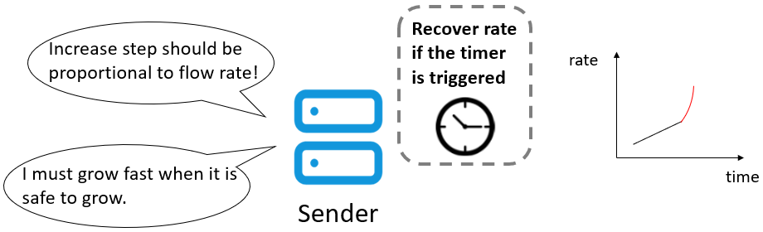
DCQCN+ Overview
Motivation
DCQCN cannot suppress an incast congestion when its number of flows exceeds hundreds.
DCQCN+ Design
Congestion scale detection
Dynamic parameters
New increase patterns
Performance
At least 10x larger scale with 20x smaller queue length
>90% throughput improvement
Adopted in RDMA adapters & ICNP’18
*DCQCN+: Taming Large-Scale Incast Congestion in RDMA over Ethernet Networks. ICNP. 2018.

Slide 44
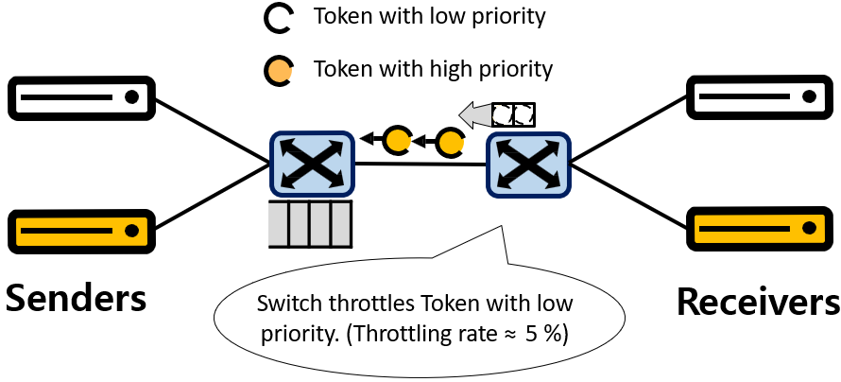
TOP Overview
Motivation
Qos-support is missing in proactive CC field.
TOP Design
In-network prioritization on tokens
Bounded queue
Credit feedback control
Performance
Reduce the average FCT and tail latency by 80-90%, especially for small flows.
TPDS’20
*Exploring Token-oriented In-network Prioritization in Datacenter Networks. TPDS. 2020.

Slide 45
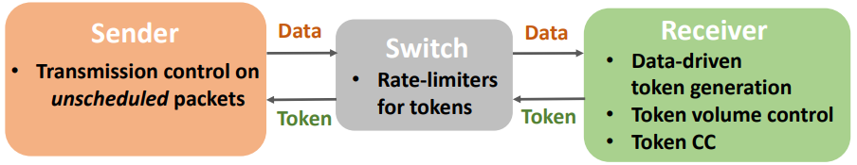
ToCC Overview
Motivation
There lacks of systematic exploration of the TCC (token-based congestion control) design space
Contributions
A framework of TCC
Devise a protocol ToCC upon the framework
Implement ToCC in NP-based NICs
Performance
Flexible for higher bandwidth links
Robust for incast scenarios
Benefits small flows by achieving a small queue length as well as benefiting large flows by obtaining stable high throughput
*An Anatomy of Token-based Congestion Control.. TON. 2025.

Slide 46
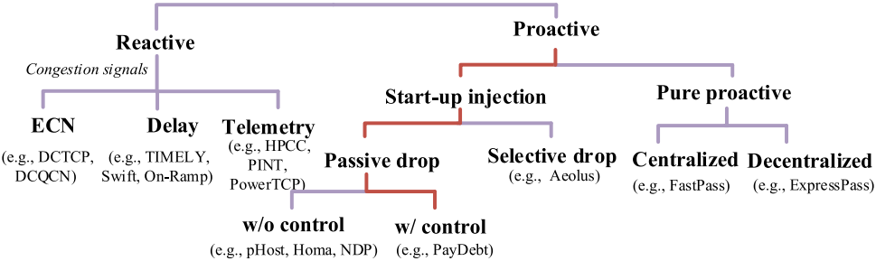
Paydebt Overview
Motivation
Existing TCC struggles with the transmission of the first RTT
Paydebt Design
Debt mechanism to paying back the unallocated bandwidth
A suitable congestion control algorithm for TCC
Performance
Reduce the FCTs of small flows by 50.2% - 85.4%
Reduce the FCTs of all flows by 13.0% - 38.1%
TPDS’22
token
sch
debt
unsch
*PayDebt: Reduce Buffer Occupancy Under Bursty Traffic on Large Clusters. TPDS. 2022.

Slide 47
PrioPlus’s Key Concept: Delay Channel
PrioPlus assigns specific delay ranges, termed as channels, to each priority.
Delay
Delay channel of the higher priority
Delay channel of this priority
Delay channel of the lower priority
*Enabling Virtual Priority in Data Center Congestion Control. Eurosys. 2025 (best student paper).

Slide 48

(Re)Discovery of the New World

Slide 49
Background
1
2
Our Thoughts
Outline
Congestion Control
3
Our Work
Flow Control
4
Future Work
Remote Flow Control
Our work

Slide 50
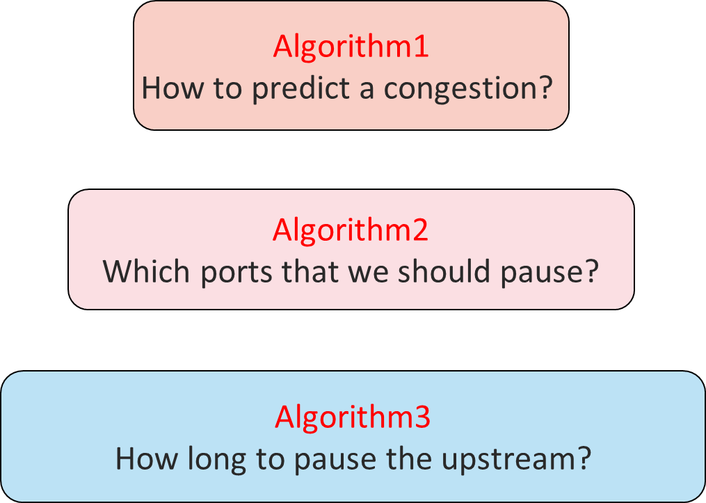
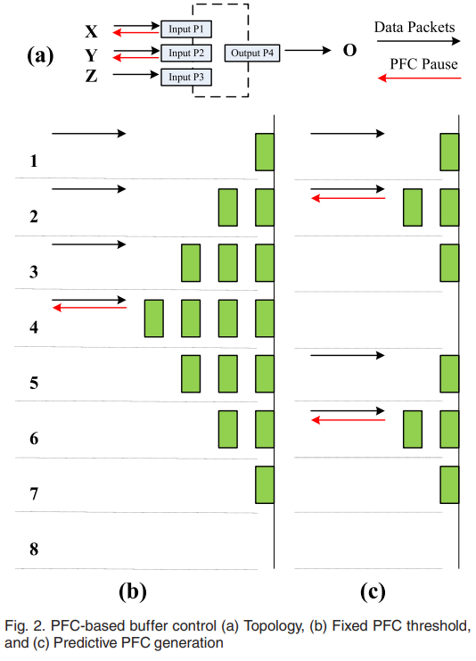
P-PFC Overview
Motivation
In PFC, An upstream port may receive PFC PAUSE continuously during the congestion phase, leading to cascading PFC pauses in upstream switches
P-PFC Design
Predict the occurrence of congestion, pausing the upstream before the queue length build up.
Performance
Reduce the maximum queue length and tail latency by 4x and 2x under high and low pressure, respectively.
TPDS’20
*P-PFC: Reducing Tail Latency with Predictive PFC in Lossless Data Center Networks. TPDS. 2020
Our work
Notes:
两个关键发现：
在网络拥塞时上游端口可能连续收到PAUSE信号，这会导致上游的级联暂停
交换机可以通过检测当前buffer的变化趋势来预测未来拥塞的产生

Slide 51
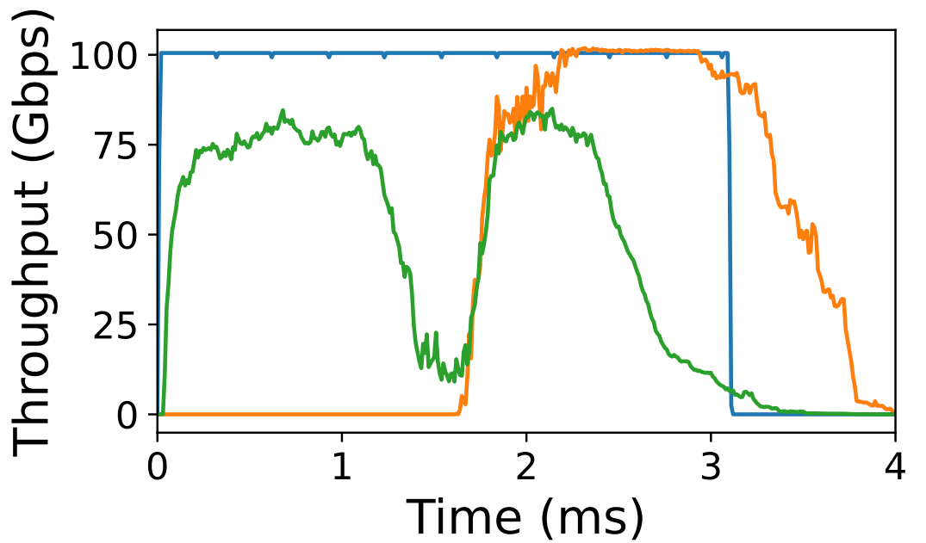
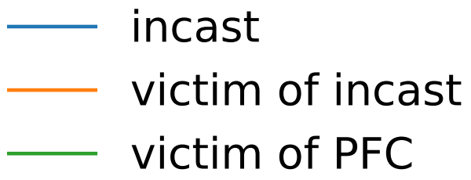
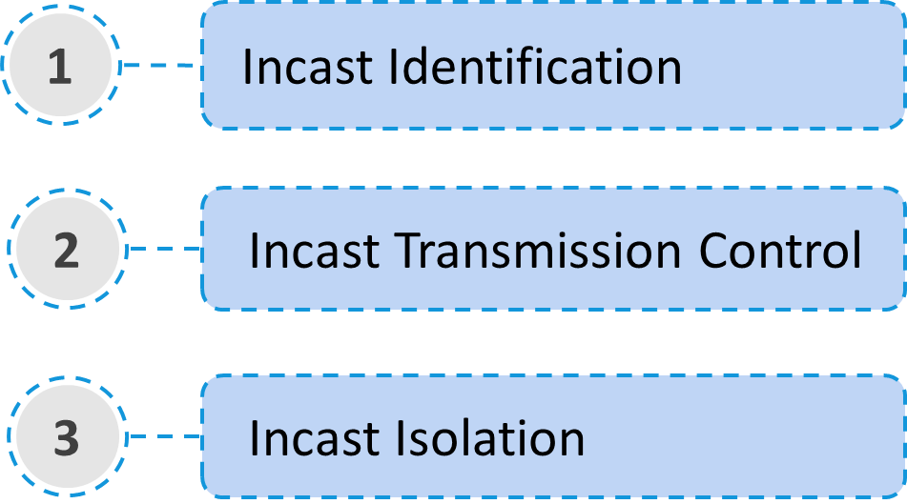
Floodgate Overview
Motivation
Incasts hurt flows’ performance, at the same time unavoidable.
Floodgate Design
A per-hop flow control that is compatible with state-of-the-art CC
A sending window to identify and control the transmission of incast flows
Leverage VOQ to isolate incast flows
Performance
Reduce the average FCTs (10.1% ~ 98.1%), as well as the 99th-tail latency (1.1 ～ 207x) under incast mixed with Possion arrival flows scenarios.
Reduce the maximum buffer occupancy by a factor of 6.6x.
CoNEXT’21
*Floodgate: Taming Incast in Datacenter Networks. CoNEXT. 2021.

Slide 52
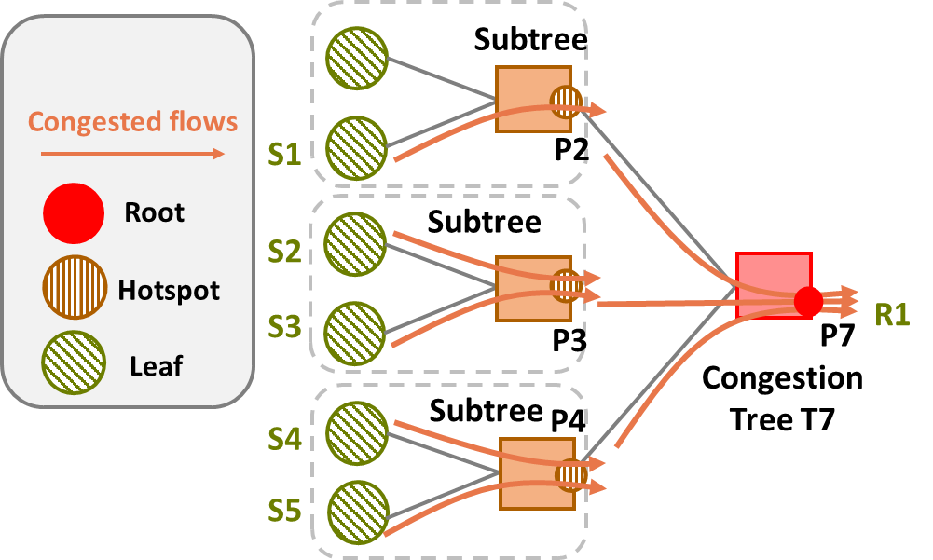
Pyrrha Overview
Motivation
There are different types of congestion in networks (e.g., incast, load imbalance)
Transient congestion can not be avoided, instead, the negative effects of it should be eliminated.
Pyrrha Design
A congestion-root based flow control that is compatible with state-of-the-art CC
Performance
The average FCT of uncongested flows is reduced by 42.8%-98.2%, and 99th-tail latency can be 1.6×-215× lower, without compromising the performance of congested flows
Reduce the maximum buffer occupancy by up to 1.8×-6.2×
NSDI’25
* Pyrrha: Congestion-Root-Based Flow Control to Eliminate Head-of-Line Blocking in Datacenter. NSDI. 2025.

Slide 53
Background
1
2
Our Thoughts
Outline
Congestion Control
3
Our Work
Flow Control
4
Future Work
Remote Flow Control
Our work

Slide 54
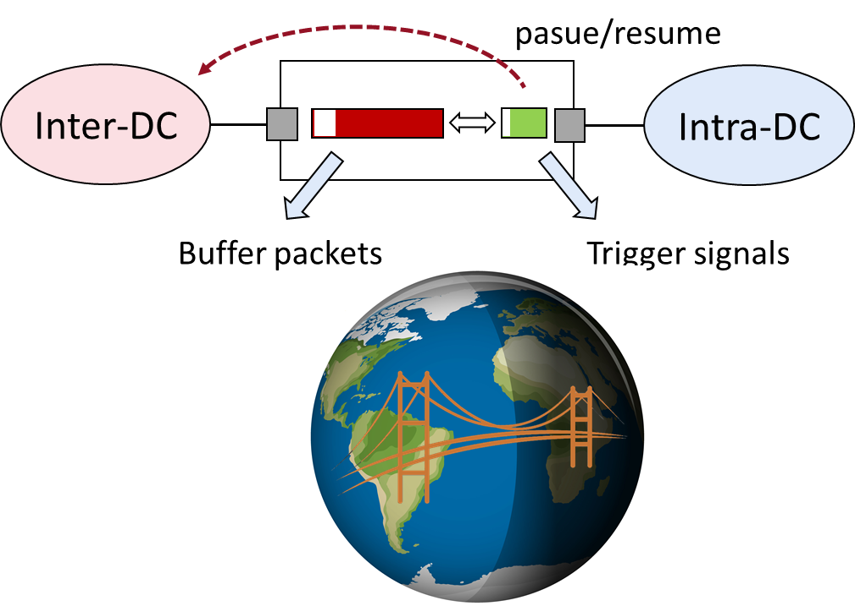
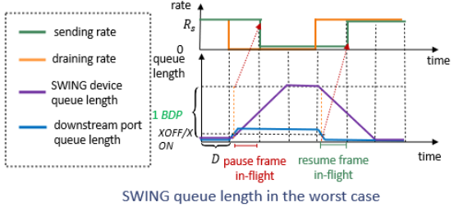
SWING Overview
Motivation
2022 年 2 月，China initiated 东数西算工程 (East Data, West Compute)
Long distance links bring
Large RTT delays the network signals (e.g., congestion signal, packet loss)
Large BDP requires deep buffer on DCI switch and increases queueing delay
SWING Design
Decouple packets buffer and FC signal trigger
A shallow buffer for intra-DC to trigger FC signal
A deep buffer for inter-DC to accommodate in-flight packets
Decouple the inter-DC and intra-DC management
FC signal can be triggered fast
Performance
Reduce the average FCT for inter-datacenter traffic by 14% - 66%
TPDS’23
*SWING: Providing Long-Range Lossless RDMA via PFC-Relay. TPDS. 2023.

Slide 55


Bifrost Overview
PFC is myopic
PFC does not know how many packets are in-flight
PFC merely focuses on queue length to make control decisions
Biofrost Design
Insights: If the downstream records what frames have been sent, it knows exactly how many packets are in-flight
Performance
Improve the performance of small flows
ICNP’23
*Bifrost: Extending RoCE for Long Distance Inter-DC Links. ICNP/TON. 2023.

Slide 56


BifrostX Overview
Multiple priorities
TON accepted
$1$ 个总令牌
$P$ 个优先级对应的令牌

Slide 57
Background
1
2
Our Thoughts
Outline
3
Our Work
4
Future Work

Slide 58




DCN in AI computing
Data Parallel
Collective communication
Pipeline Parallel
Model Parallel

Slide 59

Vertical: cross boundaries
The destination of network…
IO，
architecture，
system…
Future Work

Slide 60



Horizontal：scales
Cross-dc
Inter-nodes
Intra-nodes
Future Work

Slide 61
Long distance (e.g., inter-DC)
Lossy…
Future Work
RDMA multicast
App-oriented
New architecture
(e.g., Universal Bus)
Universal FC CC protocols…
Future Work

Slide 62

Take home idea
The time of
Flow Control is coming!
Future Work

Slide 63



Pyrrha: Congestion-Root-Based Flow Control to Eliminate Head-of-Line Blocking in Datacenter
Kexin Liu*, Zhaochen Zhang*, Chang Liu, Yizhi Wang, Vamsi Addanki, Stefan Schmid, Qingyue Wang, Wei Chen, Xiaoliang Wang, Jiaqi Zheng, Wenhao Sun, Tao Wu, Ke Meng, Fei Chen, Weiguang Wang, Bingyang Liu, Wanchun Dou, Guihai Chen, Chen Tian
Notes:
Hello everyone, this is ________ from Nanjing University.
Today, I am delighted to share with you Pyrrha, which is focused on managing transient congestion using scalable and head-of-line-blocking-free flow control.

Slide 64


Due to VISA issue...
Kexin Liu
Receives her Ph.D. Degree at 2023. Her research interests include congestion management in Datacenter and building network stack for AI clusters.
She is now a senior research engineer in Huawei.
Zhaochen Zhang
He is a Ph.D. candidate from Nanjing University. His research interests focus on the transport layer in data center, including congestion management, and reliable transmission.
He is planning to graduate in 2026 and is in the job market.
Notes:
Due to visa issues, both co-first authors of this paper are unable to attend NSDI, so I am presenting on their behalf.
Firstly, let me provide some background information.

Slide 65

CC is Falling for Transient Congestion
Trend1: The high port bandwidth allows sending out more flows within
the first RTT, even before congestion control could step in.
Flow Size (Bytes)
Figure source: Harmony@NSDI '24
Notes:
With data center networks evolving, there are three trends making congestion control increasingly struggle to manage transient congestion.
The first trend is that as port bandwidth grows, more and more flows can be sent out in the first RTT. Since most congestion controls require one RTT to receive the congestion signal, they cannot manage the transient congestion caused by the first RTT traffic.

Slide 66


CC is Falling for Transient Congestion
Trend2: The growing scale of DCN and the emerging workloads (e.g., distributed training) lead to more bursty traffic.
Figure source: HPN@Sigcomm ‘24
Notes:
The second trend is that the increasing scale of data center networks and the emergence of workloads such as distributed training will result in more bursty traffic, which means more transient congestion.
// For example, a paper from Alibaba reports its training data center will have fifteen thousand NICs in a pod. And the traffic pattern of each NIC is periodic bursts. This trend may lead to more frequent and larger-scale transient congestion.

Slide 67

CC is Falling for Transient Congestion
Trend3: The decreasing buffer-to-bandwidth ratio calls for faster congestion management for transient congestion.
Figure source: PrioPlus@EuroSys ‘25
Notes:
The third trend that makes the situation worse is the decreasing buffer-to-bandwidth ratio, which significantly reduces switches’ ability to absorb transient congestion.

Slide 68
CC is Falling for Transient Congestion
Trend3: The decreasing buffer-to-bandwidth ratio calls for faster congestion management for transient congestion.
Data center networks need to manage transient congestion more quickly.
Figure source: PrioPlus@EuroSys ‘25
Notes:
These three trends together demand that data center networks should have an enhanced ability to manage transient congestion more quickly.

Slide 69


Our Vision for Data Center Congestion Management
Per-hop FC handles transient congestion.
End-to-end CC handles persistent congestion.
End-to-end
Congestion
Control
Per-hop Flow Management
Switch
Switch
FC frames
Sender
Receiver
CC signals
Notes:
To solve the transient congestion problem, our vision
⊕ is to leverage per-hop flow control to handle transient congestion.
When applying per-hop flow control, a switch can manage congestion using control frames within a one-hop transmission delay of around one microsecond.
// It is in a unique position to quickly manage flows that have already been injected into the network to avoid performance downgrades.
⊕ And traditional congestion control could be used to adjust flow rates at the end host to avoid persistent congestion.
This labor division between congestion control and per-hop flow control leverages their unique positions to collaboratively manage data center congestion. We will later demonstrate the effectiveness of this division. Next, let’s explore the drawbacks of existing per-hop flow controls.
// Note that later in the presentation, we will use the terms "per-hop flow control" and "flow control" interchangeably.

Slide 70
HOL Blocking Problem of Naive FC
Head-of-Line Blocking: a flow is paused innocently by the congested port that it does not pass through.
HOL Blocking!
Queue at P3 in PFC
Vulnerable flows
Paused!
Congested flows
P3
Blocked!
Congested port
Uncongested port
Pause
P1
Paused
port
P4
P2
Notes:
Naive flow control like PFC is widely used to avoid buffer overflow in the RoCEv2 network. However, PFC is well-known for incurring head-of-line blocking, a performance killer in RoCEv2.
Let’s use the scenario shown on the screen as an example to introduce head-of-line blocking in detail. In this scenario, multiple congested flows intersect at port P2,
⊕ causing congestion and triggering PFC to pause P3 and P4.
⊕ Let's assume another vulnerable flow
⊕ shares the same queue with the congested flow on P3 and then passes P1.
⊕ Although this flow does not pass the congested port and allowing it to send will not cause buffer overflow, it will also be paused innocently, which is called head-of-line blocking. // When ingress queue length exceeds a threshold, PFC pauses the upstream in per-priority-queue granularity. PFC is well-known for incurring head-of-line blocking, a performance killer in RoCEv2.

Slide 71
HOL Blocking Problem of Naive FC
Test workload:
continuous incast flows
Receiver
Notes:
To demonstrate the impact of head-of-line blocking on performance, we conduct a simulation in a fat-tree topology.
The test workload consists of three types of flows. Incast flows start at the beginning of the simulation, in which all other hosts send small flows to the last host in the topology, making the last pod congested.

Slide 72
HOL Blocking Problem of Naive FC
Test workload:
continuous incast flows +
vulnerable flows with a total rate of 80 Gbps
Receiver
Notes:
Vulnerable flows are flows sent from other pods to other hosts in the last pods with the total rate being eighty gigabits per second. These flows may suffer from head-of-line blocking at destination aggregation switches and core switches.

Slide 73
HOL Blocking Problem of Naive FC
Test workload:
continuous incast flows +
vulnerable flows with a total rate of 80 Gbps +
background flows with a total rate of 80 Gbps
Notes:
And background flows are sent between uncongested pods with the total rate being eighty gigabits per second. These flows could also be blocked if congestion is not properly controlled and spread to other pods.

Slide 74

HOL Blocking Problem of Naive FC
PFC: The throughput of vulnerable flows and background flows is severely hurt due to HOL blocking.
Notes:
The result of PFC is shown on the screen.
⊕ During the first two microseconds, vulnerable flows are significantly blocked.
⊕ Between the first and second microsecond, congestion spreads to all of the pods, blocking background flows.
This result reveals that head-of-line blocking incurred by PFC significantly impacts the transmission of uncongested flows. Additionally, CBFC performs similarly to PFC, as they both control transmission at the granularity of the entire queue.

Slide 75
Idealized FC can Eliminate HOL blocking but is Non-scalable
Per-flow-queue FC: Vulnerable and background flows fully utilize the link, at the same time the throughput of incast flows does not downgrade.
Not scalable: There could be thousands of flows that can be observed on a port [1,2].
[1] (EuroSys18) Information rich flow record generation on commodity switches.
[2] (SigMetric24) Lightweight Acquisition and Ranging of Flows in the Data Plane.
Notes:
To overcome the head-of-line blocking caused by coarse-grained control, an idealized way is per-flow queue flow control, where only queues assigned to congested flows are paused and uncongested flows are unaffected.
⊕ However, this solution is not scalable as there could be thousands of flows observed on a port.

Slide 76

State-of-the-art FC is Flawed
BFC@NSDI22: Vulnerable and background flows sharing the same queue with incast flows are severely hurt.
Notes:
BFC, the state-of-the-art flow control, attempts to mimic per-flow-queue using a limited number of queues. When the number of active flows exceeds the number of queues, the remaining flows are randomly assigned to the already-used queues.
⊕ As shown in the figure, although many uncongested flows complete quickly, some flows take a long time because they randomly share queues with congested flows and suffer from head-of-line blocking.

Slide 77

State-of-the-art FC is Flawed
BFC@NSDI22: Vulnerable and background flows sharing the same queue with incast flows are severely hurt.
How to eliminate HOL blocking caused by
flow control in the most cost-effective way
Notes:
Given this situation, we raise the question:
How to eliminate head-of-line blocking caused by flow control in the most cost-effective way?

Slide 78
We Need a Better Control Granularity for Per-hop FC
PFC’s control granularity:
control the entire priority queue.
Head-of-line blocking.
Per-flow-queue’s control granularity: control at the flow granularity.
Non-scalable.
A better control granularity?
Blocking-free and scalable.
Notes:
Reviewing existing per-hop flow control protocols, we find that the key is control granularity. A coarse control granularity can lead to head-of-line blocking, while overly fine granularity can result in excessive resource consumption, making it non-scalable. Therefore, we need to find a better control granularity.

Slide 79
Analysis of Congestion in Per-hop FC
Vulnerable flows
Congested flows
P3
Root
Pause
Pause
P1
Hotspot
P4
P2
Leaf
P5
Notes:
Our analysis begins with the congestion in per-hop flow control, which is illustrated through this example.
In the example,
⊕ Five flows intersect at P2, causing congestion,
⊕ which then triggers pauses to P3, P4, and P5. As flows continue to transmit,
⊕ the queue lengths at P3, P4, and P5 increase, leading to pauses to upstream ports.

Slide 80
Analysis of Congestion in Per-hop FC
Vulnerable flows
Congested flows
P3
Congestion Root
Root
P1
Hotspot
P4
P2
Leaf
Congestion Tree
P5
Notes:
Analyzing the ports involved in this congestion event, we found they naturally form a tree structure. Only the congestion at P2 is unavoidable, and the congestion at other ports is triggered by pauses from P2.
⊕ Therefore, P2 is both the root of the tree structure and the root cause of the congestion, referred to as the congestion root.
// Ports that are both paused by the congestion root and pause other ports are called hotspots, while ports that are paused but do not pause any upstream ports are called leaves.

Slide 81
Analysis of Congestion in Per-hop FC
Key insight: Congestion root is the appropriate granularity of flow control!
Only control the flows passing through the congestion root.
Blocking-free.
The number of concurrent congestion roots observed on each port is moderate [3].
Scalable.
[3] (IMC) Network traffic characteristics of data centers in the wild.
Notes:
Since the congestion root is the root cause of congestion, the flows contributing to it form the minimal set that must be controlled. By only controlling these flows, other flows will not be blocked.
⊕ And the number of concurrent congestion roots observed on each port is moderate. Therefore, only a reasonably small amount of resources is required at each port, making the flow control scalable.
⊕ According to our analysis, we conclude the key insight of this work: congestion root is the appropriate granularity of flow control to achieve both blocking-free and scalable.

Slide 82
Pyrrha: A Congestion-Root-Based Flow Control
Queue allocation at P3
Vulnerable flows
Default output queue (OQ)
Congested flows
P3
Isolation queue (IQ) for root P5
Root
Pause
Pause
P1
Hotspot
P4
P2
Leaf
P5
Notes:
Based on the insight, we propose Pyrrha, a congestion-root-based per-hop flow control protocol.
Specifically, the Pyrrha switch will embed the congestion root ID in the pause frame. Upon receiving a pause frame, the upstream Pyrrha switch allocates an isolation queue dedicated to the congestion root. Then traffic passing through the congestion root is placed into the isolation queue. Traffic that does not pass through the congestion root remains unaffected by the congestion.

Slide 83

Pyrrha: A Congestion-Root-Based Flow Control
Queue allocation at P3
Vulnerable flows
Pyrrha is a HOL-blocking free per-hop FC protocol requiring the minimal number of queues.
Default output queue (OQ)
Congested flows
P3
Isolation queue (IQ) for root P5
Root
Pause
Pause
P1
Hotspot
（formally proven in the technical report released with our paper.)
P4
P2
Leaf
P5
Notes:
By leveraging congestion root as the control granularity, Pyrrha can be formally proven as a head-of-line-blocking-free flow control protocol requiring minimal queues. Please see the technical report released together with our paper for the formal proof.
However, to realize congestion root-based flow control, there are some challenges to be solved.

Slide 84
Key Challenge: Identify Congestion Root
HOL Blocking!
Vulnerable flows
Congested flows
P3
Root
P1
Hotspot
P4
P2
Leaf
P5
Notes:
The first challenge as well as the key challenge is identifying the congestion root accurately.
This is difficult in practice because upstream non-root hotspots can become congested before the actual congestion root. For example,
⊕ non-root port P3 might be congested first, and pause flows passing through it.
⊕ However, the true congestion root is P2.
⊕ If Pyrrha cannot converge to recognize P2 as the root, it can cause head-of-line blocking for the vulnerable flow that does not pass through P2.

Slide 85

Pyrrha Design: Distributed Congestion Root Election
P6
Queues at P3
Vulnerable flows
Default output queue (OQ)
I am the root!
Congested flows
$$K_{pause}$$
P3
Pause
Root
P1
Hotspot
P4
P2
Leaf
P5
Notes:
Inspired by the Spanning Tree Protocol, Pyrrha proposes a distributed congestion root election mechanism. This approach is based on the fact that congestion roots are always downstream, which ensures accurate root identification.
We use the following example to illustrate the process of distributed root election.
⊕ When there is no congestion, all flows are enqueued into the port's output queue.
⊕ If the output queue length exceeds the congestion threshold,
⊕ the port claims itself as the root and sends pause frames with its port ID upstream.

Slide 86
Pyrrha Design: Distributed Congestion Root Election
P6
Queues at P6
Vulnerable flows
Default output queue (OQ)
I am the root!
Congested flows
Isolation queue (IQ) for root P3
P3
Pause
Root
P1
Hotspot
P4
P2
Leaf
P5
Notes:
Upon receiving the pause frame,
⊕ the upstream port assigns an IQ dedicated to the congestion root
⊕ and enqueues the flow passing through the congestion root into the IQ.

Slide 87
Pyrrha Design: Distributed Congestion Root Election
P6
Vulnerable flows
I am the root!
Congested flows
P3
Pause
Root
Pause
P1
Hotspot
I am the root!
P4
P2
Leaf
P5
Notes:
When the downstream port P2 also experiences congestion, it identifies itself as the congestion root
⊕ and sends pause frames with its ID to the upstream ports.

Slide 88
Pyrrha Design: Distributed Congestion Root Election
P6
Vulnerable flows
P2 is the root!
Congested flows
P3
Merge
Root
Pause
P1
Hotspot
I am the root!
P4
P2
Leaf
P5
Notes:
Upon receiving this pause frame, the upstream port P3 relinquishes and recognizes P5 as the new congestion root.
After a new root is elected, Pyrrha merges the old congestion tree into the new one.
⊕ This process is achieved by sending Merge frames from the false-positive root P3 to upstream ports. When P6 receives the merge frame, it cancels the IQ assigned to P3, allowing the vulnerable flow to be free of the blocking.
After the actual congestion root arises, the congestion root election and merge process finishes within several link delays. Therefore, false-positive congestion roots have a minimal impact on performance.

Slide 89
Challenge 2: Identify Congested Flows
P6
Vulnerable flows
Congested flows
P3
Root
P1
Hotspot
P4
P2
Leaf
P5
Will the new flow pass through
the congestion root P2？
P7
Notes:
The second challenge is identifying congested flows.
Pyrrha actively identifies and controls congested flows rather than passively reacting after they reach the congestion root.
⊕ This approach prevents additional pressure from being placed on the congestion root by new flows.
⊕ To determine whether a flow will pass through the congestion root, the Pyrrha switch needs to identify the onward path of each flow.
This is challenging as various load balancing protocols may be applied in data centers, which can complicate determining the path of packets.

Slide 90
Challenge 2: Identify Congested Flows
In data centers, various load balancing protocols may be applied, which can complicate determining the path of data packets.
Source routing
ECMP
Packet spraying
FlowBender (Sigcomm14)
CONGA (Sigcomm14)
LetFlow (NSDI17)
DRILL (Sigcomm17)
PLB (Sigcomm22)
ConWeave (Sigcomm23)
Notes:
This is challenging as various load balancing protocols may be applied in data centers, which can complicate determining the path of packets.

Slide 91
Design 2: Hash-aware Path Calculation
In data centers, LB protocols can be categorized into three types, all of which are compatible with Pyrrha.
Source routing
Path information is directly embedded in the packet header
CONGA (Sigcomm14)
ConWeave (Sigcomm23)
ECMP
Path is calculated through hash function at each hop
FlowBender (Sigcomm14)
PLB (Sigcomm22)
Packet spraying
Please see our paper for how Pyrrha work with dynamic LB protocols.
DRILL (Sigcomm17)
Notes:
In data centers, LB protocols can be categorized into three types,
⊕ The first type of LB protocols directly embeds path information into the packet header, //such as source routing or CONGA.
These routing protocols naturally compatible with Pyrrha.
⊕ The second type uses a hash function to calculate the forwarding path at each hop, like ECMP// or FlowBender.
For this type of LB, we propose an efficient hash-aware path calculation method to determine paths on switch, which will be detailed next.
⊕ For dynamic LB protocols which have unpredictable paths, Pyrrha can still work with it on the downlinks in a clos topology. Please refer to our paper for details.

Slide 92
Design 2: Hash-aware Path Calculation
Challenge: To determine the path of a packet, a switch must know the hash results of other switches.
Our finding: Current switches only provide a limited number of hash functions to prevent complex hashing from impeding forwarding rates [4,5].
Our solution: Only store the hash function types and hash seeds used by other switches to calculate the hash results.
[4] (FAST05) A scalable and high performance software iscsi implementation.
[5] (ATC22) Hashing design in modern networks: Challenges and mitigation techniques.
Notes:
For hash-based LB protocols, the challenge in calculating path is that a switch must know the hash results of other switches.
⊕ By leveraging the finding that current switches only provide a limited number of hash functions to prevent complex hashing from impeding forwarding rates,
⊕ Pyrrha switch only needs to store the hash function types and hash seeds used by other switches to calculate the hash results.

Slide 93
Challenge 3: Handle Tree-tangling Scenarios
Vulnerable flows
Congested flows
P4
Root
P1
P2
Hotspot
P5
P3
Leaf
P7
P8
P6
P9
Notes:
The third challenge is handling tree-tangling scenarios.
Several concurrent congestion trees can be intertwined among themselves. As an example, after a congestion tree forms with P2 as the root,
⊕ two additional flows from P8 and P9 are sent to P6 and then pass through P3.
⊕ The new flows, which are not part of the congestion tree rooted at P2, will cause P6’s OQ congestion, prompting P6 to declare itself the root and pause these flows.
In this case, two congestion trees tangle with each other.

Slide 94
Challenge 3: Handle Tree-tangling Scenarios
Vulnerable flows
Congested flows
P4
Root
P1
P2
Hotspot
P5
P3
Leaf
P7
P8
P6
Congestion Tree rooted at P2
P9
Notes:
The first is the congestion tree rooted at P5

Slide 95
Challenge 3: Handle Tree-tangling Scenarios
Vulnerable flows
Congested flows
P4
Root
P1
P2
Hotspot
P5
P3
Leaf
P7
P8
P6
Congestion Tree rooted at P6
P9
Notes:
And the second is the congestion tree rooted at P6

Slide 96
Challenge 3: Handle Tree-tangling Scenarios
Vulnerable flows
Congested flows
P4
Root
P1
P2
Hotspot
P5
P3
Leaf
P7
P8
P6
Tree-tangling
P9
Notes:
This results in P6 being both a hotspot and a congestion root, and the flow sent from P7 passes through two congestion roots, posing challenges for the flow control mechanism.

Slide 97
Challenge 3: Handle Tree-tangling Scenarios
Vulnerable flows
Congested flows
P4
Please see our paper for how Pyrrha identifies congestion flows and handles tree-tangling scenarios.
Root
P1
P2
Hotspot
P5
P3
Leaf
P7
P8
P6
Tree-tangling
P9
Notes:
For reasons of time, we omit Pyrrha’s design on the last two challenges. Please see our paper for details.

Slide 98

Pyrrha’s Prototype
We implement a Pyrrha prototype on Tofino2 with 2.5k lines of P4 code and 2k lines of Python code.
Notes:
Pyrrha is implementable. We implement a Pyrrha prototype on Tofino2.

Slide 99

Pyrrha’s Prototype: Optimization
The multiple equal path and up-down routing properties of typical data center topologies are leveraged to enable Pyrrha to calculate paths for a topology with 11,664 hosts (fat-tree with k=36) using just 440 KB of storage.

Slide 100

Pyrrha’s Prototype: Optimization
An innovative Multi-segment QueueID Stack is used, allowing one-pass allocation and freeing of queues within Tofino2's pipeline architecture.

Slide 101


Pyrrha’s Prototype: Compromise
Queue state tables require $\#switch port × \#potential roots$ storage$.$ This overhead is unoptimizable due to Tofino2's pipeline architecture, consuming 8.64MB of storage in an 11,664 hosts (fat-tree with k=36) topology.

Slide 102
The Overhead of Pyrrha’s Prototype
Our Pyrrha prototype can easily scale to a k=36 fat-tree topology (≈11k hosts), with around 11 MB (44.5% of Tofino2) memory resource consumption.
Notes:
With careful optimizations, it requires only forty percent of Tofino2 memory resources to support around ten thousand hosts.

Slide 103


Testbed Evaluation
Pyrrha significantly reduces the FCT of vulnerable flows compared with PFC.
Topology: 2-stage clos topology with 2 cores and 3 ToRs.
Workload: Web Server and Web Search.
Notes:
We tested the performance of the Pyrrha prototype in a two-stage Clos topology where all switches are running Pyrrha. Under both web server and web search workloads, Pyrrha significantly reduced the FCT compared with PFC.

Slide 104

Simulation Evaluation
FCT in incast-mix scenario, compare with other FCs
Topology: 2-stage clos topology with 160 hosts.
Incast flows: periodically generated with average load at 0.5.
Vulnerable and background flows: generated following Poisson process with load at 0.8.
Basically the same
~200x
~30x
Notes:
Next, we give some simulation evaluation results on Pyrrha.
In a simulation with a one-hundred-and-sixty host topology, compared with other flow control protocols,
⊕ Pyrrha improves the performance of vulnerable and background flows significantly,
⊕ without compromising the performance of congested flows.

Slide 105

Simulation Evaluation
FCT in incast-mix scenario, with or without CC
~150x
~20x
~2x
~2x
Pyrrha significantly benefits uncongested flows compare with pure CC solution.
Pyrrha can cooperate with existing CC to achieve better performance for small flows.
Notes:
Compared with a pure congestion control solution,
⊕ Pyrrha also significantly benefits vulnerable and background flows without compromising congested flows.
⊕ When Pyrrha cooperates with congestion control, the performance of small flows is further improved.

Slide 106

Simulation Evaluation
Pyrrha’s queue usage is moderate
Topology: standard fat-tree with k=16 (1024 hosts).
Most stressful workload: (m − 1) out of m ToRs send traffic simultaneously to the left 1/m of the ToRs.
Notes:
We also investigate the worst-case queue usage of Pyrrha. In a simulation with 1024 hosts and the most stressful workload, Pyrrha’s queue usage is under twenty, which is moderate.

Slide 107
Conclusion
Pyrrha is a congestion-root-based per-hop flow control, which can control the transmission of flows at a fine granularity without HOL blocking while requiring only a minimal number of queues.
It is time to embrace per-hop flow control to react to congestion promptly！
Thanks！
Find our open-source code on: https://github.com/NASA-NJU/Pyrrha
Notes:
Finally, let me make a conclusion.
Pyrrha is a congestion-root-based per-hop flow control protocol, which can control the transmission of flows at a fine granularity without HOL blocking while requiring only a minimal number of queues.
Through Pyrrha, we demonstrate that a head-of-line blocking-free, scalable flow control is feasible. We believe that it is time to embrace per-hop flow control to react to congestion promptly.
// Our codes are publicly available online as a contribution to the research community and to ensure reproducibility.
Thanks for listening.

Slide 108

Idealized FC can Eliminate HOL blocking but is Non-scalable
Per-flow-queue FC: Vulnerable and background flows fully utilize the link, at the same time the throughput of incast flows does not downgrade.
Notes:
To overcome the head-of-line blocking caused by coarse-grained control, an idealized way is per-flow queue flow control, where only queues assigned to congested flows are paused and uncongested flows are unaffected.
As shown by the result, when adopt this method, vulnerable and background flows fully utilize the link, at the same time the throughput of incast flows does not downgrade.

Slide 109

Simulation Evaluation
Buffer backlog in incast-mix scenario, with or without CC
Pyrrha can avoid congested flows overflow the congestion root and balance the buffer among the switches.
Notes:
The detailed analysis on buffer backlog reveals Pyrrha’s ability to manage switch buffer: Pyrrha can avoid congested flows overflow the congestion root and balance the buffer among the switches.

Slide 110
Pyrrha’s Prototype: Compromise
Pyrrha needs Hierarchical Isolation Queue (HIQ) to handle tree-tangling scenarios.
Although HIQ is supported by some commodity switches [6,7], it is not supported by Tofino2 currently.
[6] (Juniper) Hierarchical class of service overview.
https://www.juniper. net/documentation/us/en/software/junos/cos/topics/ concept/hierarchical-cos-overview.html, 2021.
[7] (Huawei) Introduction to hqos.
https://support.huawei.com/ hedex/hdx.do?docid=EDOC1100168821&id=EN-US_TASK_ 0172371452&lang=en, 2022.

Slide 111
Pyrrha’s Prototype: Compromise
Fortunately, the features of HIQ can be fully supported via single-tier queues.
P4
IQ-P6
IQ-P2
OQ
P1
P5
P2
P7
P3
IQ-P2
P8
Tree-tangling
P6
P9
IQ-P5
IQ-P2&p5

Slide 112
Thanks!
Any questions?

